Slide 1

CAPSTONE PROJECT PROJECT TITLE
Dyslexia Assistant
Presented By
Student Name:Kadali Rajesh
College Name:NRI institute of technology
Department:computer science and engineering
Email ID:kadalijyothi99@gmail.com
AICTE Student ID:STU67618668182e11734444648

Slide 2
OUTLINE
Problem Statement (Should not include solution)
Proposed System/Solution
System Development Approach (Technology Used)
Algorithm & Deployment
Result (Output Image)
Conclusion
Future Scope
References

Slide 3
Problem Statement
Dyslexia is a common learning difficulty that affects a person's ability to read, write, and spell, even though their intelligence is often average or above average. It is estimated that 10–15% of students globally have some form of dyslexia, yet most educational materials are not designed with accessibility in mind.
Students with dyslexia often face:
Difficulty understanding dense academic text
Frustration caused by complex sentence structures and unfamiliar vocabulary
Fatigue from prolonged reading sessions
Limited access to assistive technologies, especially in low-resource environments
These challenges not only impact academic performance but also self-esteem and long-term learning outcomes. Most available tools are either expensive, language-limited, or not personalized for students in non-English-speaking regions (like India or Norway).
There is a strong need for a free, AI-powered tool that:
Simplifies complex academic content
Reads text aloud in a natural voice
Makes learning more inclusive and confidence-building

Slide 4
Proposed Solution
To address the reading and comprehension challenges faced by students with dyslexia, this project proposes an AI-powered reading assistant that simplifies academic content and makes it more accessible.
Key Features of the Solution:
Text Extraction: Extracts text from educational materials such as PDF files, scanned documents, or images using OCR or PDF readers.
Language Simplification: .simplifies complex sentences using the open-source T5 model (from Hugging Face). The simplified content is optionally read aloud using the gTTS (Google Text-to-Speech) library, making learning easier for dyslexic students — all running for free on Google Colab.
Customizable: The system can be tailored to different reading levels or even translated into other languages for local support.
Audio Output: Converts simplified text into speech using Azure Text-to-Speech, enabling auditory learning and reducing reading fatigue.
Goals:
Reduce the reading burden for dyslexic students
Improve comprehension and retention of academic content
Promote inclusive, AI-powered education
Make the tool freely available for schools, tutors, and individuals
This solution is developed entirely using Microsoft Azure services and open-source Python tools, making it cost-effective, scalable, and internship-compliant.

Slide 5
System Approach
System Requirements
Operating System: Windows / Linux / Google Colab (Cloud)
Programming Language: Python 3.x
Cloud Platform: Microsoft Azure (Student Subscription)
Internet Access: Required for Azure API access (OpenAI & Speech Services)
Processor: Any modern CPU (no GPU needed for this NLP-focused project)
Libraries and Tools Used
openai – for accessing Azure OpenAI (GPT-3.5)
PyMuPDF (fitz) – to extract text from PDFs
azure-cognitiveservices-speech – to convert simplified text to speech
gTTS (fallback) – optional alternative for speech synthesis in Colab
Streamlit (optional) – to build a simple web UI (future scope)
Google Colab (optional) – used for development and testing without local setup
Cloud Services (Azure)
T5-small (transformers)– for text simplification gTTS– for generating speech from text
Azure Blob Storage (optional) – to store uploaded files or audio outputs Google Colab (for free development, no API keys required)
Development Platform
The entire system is developed in Python using Jupyter Notebook or Google Colab for simplicity.
Azure services are integrated using API calls and SDKs, making the solution lightweight and cloud-ready. No paid APIs used
Runs fully on Python and open-source models

Slide 6
Algorithm & Deployment
The Dyslexia Assistant+ follows a clear and modular pipeline to process input content and generate simplified, accessible output for users. Below is the step-by-step flow of how the system works:
Step-by-Step Flow: 1. Upload Input File The user uploads a PDF document containing academic content. This serves as the input to the system.
2. Text Extraction The system extracts readable text from the uploaded PDF using the PyMuPDF (fitz) library.
3. Preprocessing (Optional) The extracted text is cleaned and formatted — removing extra whitespace, line breaks, or unwanted characters.
4. Text Simplification Using T5 The cleaned content is passed to a T5-small model (open-source, Hugging Face), which rewrites complex sentences into simpler, easy-to-read versions.
5. Text-to-Speech Conversion (Optional) The simplified text is converted into audio using the gTTS (Google Text-to-Speech) library for auditory learning support.
6. Output Delivery The final output is:
Displayed as simplified text on the screen
Optionally played back as audio This makes the reading experience more accessible and inclusive for dyslexic learners.
The algorithm is designed to be efficient, modular, and accessible. It can be enhanced in the future with translation, personalization, and voice input support.

Slide 7
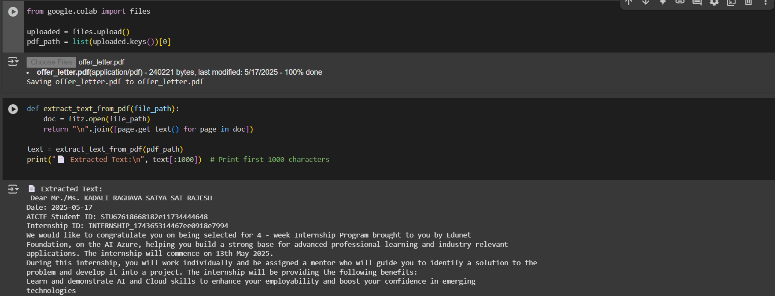
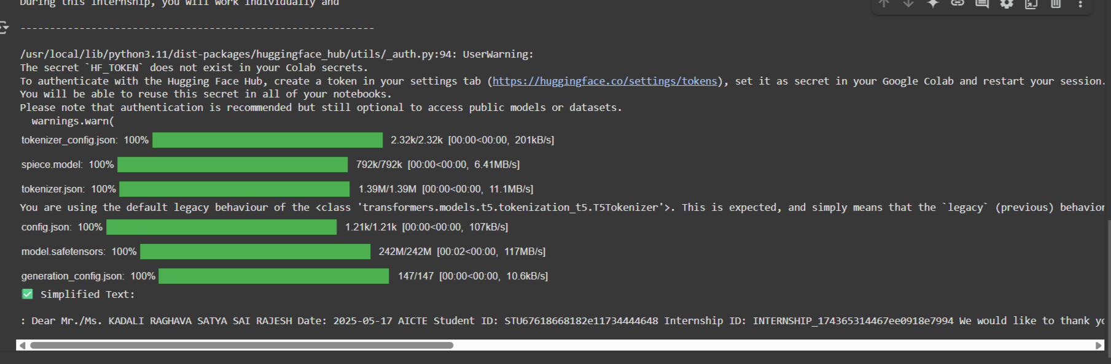
Result
Simplified Text: : Dear Mr./Ms. KADALI RAGHAVA SATYA SAI RAJESH Date: 2025-05-17 AICTE Student ID: STU67618668182e11734444648 Internship ID: INTERNSHIP_174365314467ee0918e7994 We would like to thank you for being selected for 4 - week Internship Program brought to you by Edunet Foundation, on the AI Azure

Slide 8
Conclusion
The Dyslexia Assistant+ project demonstrates how modern AI tools can be meaningfully applied to solve real-world educational challenges. By combining Azure OpenAI and Azure Speech services, the system simplifies academic content and provides auditory support for students with dyslexia.
Key Takeaways:
AI can make learning more inclusive by adapting content to suit different learning needs.
Cloud platforms like Microsoft Azure provide powerful, scalable services that can be integrated with minimal cost — especially beneficial for student developers.
The project was successfully implemented using free student resources and aligns well with the goals of the AICTE Edunet Azure + AI internship program.
The tool not only improves reading comprehension for dyslexic learners but also empowers them to engage more confidently with academic materials — paving the way for AI-assisted education for all.

Slide 9
Future scope
The Dyslexia Assistant+ is a strong foundational tool, but its potential can be greatly expanded with advanced features, multilingual support, and integration into everyday learning platforms.
Planned Enhancements:
Multilingual Simplification Add support for translating and simplifying content in native languages like Hindi, Tamil, or even Norwegian — to support a broader group of learners globally.
Adaptive Learning Mode Personalize the level of simplification based on user profiles (beginner, intermediate, advanced) to match the student’s current reading skill.
Voice Input Capability Allow students to speak text out loud and get simplified explanations or definitions in return — useful for low-literacy or hands-free scenarios.
Browser Extension Build a Chrome/Edge extension that lets users simplify and listen to text directly from websites or online textbooks in real time.
Mobile App Deployment Create an Android/iOS version so users can upload and simplify documents on the go — expanding reach and usability.
Integration with LMS Platforms Connect the tool with online learning platforms like Microsoft Teams, Google Classroom, or Moodle for classroom-wide accessibility.
These additions will help the project evolve into a full-fledged AI-powered assistive tool for education — scalable, accessible, and life-changing for dyslexic learners.

Slide 10
References
Technical References
Microsoft Azure OpenAI Service https://learn.microsoft.com/en-us/azure/cognitive-services/openai/
Azure Speech Service https://learn.microsoft.com/en-us/azure/cognitive-services/speech-service/
PyMuPDF (fitz) Library for PDF Text Extraction https://pymupdf.readthedocs.io/
OpenAI API (GPT-3.5/4) https://platform.openai.com/docs
T5 Model – https://huggingface.co/t5-small
Hugging Face Transformers – https://huggingface.co/transformers
PyMuPDF – https://pymupdf.readthedocs.io
gTTS – https://pypi.org/project/gTTS/
Research & Contextual References
International Dyslexia Association – https://dyslexiaida.org
British Dyslexia Association – https://www.bdadyslexia.org.uk
The development of Dyslexia Assistant+ was guided by official documentation, research studies on dyslexia, and tools provided under the Microsoft Azure platform.
All tools used in this project are open source or available under free student subscriptions on Microsoft Azure.
GitHub Link: https://github.com/Rajesh665-mw/Dyslexia-Assistant.git

Slide 11
Thank you

